Slide 1
Introduction to Java
2

Slide 2
Before Java
How java language is originated.
In 1990 Sun microsystems inc. (US) has started a project to develop software for consumer electronic devices that could controlled by a remote.--- Stealth project later renamed Green Project.
In 1991 , Bill Joy, James Gosling, Mike sheradin, Patrick Naughton and other discussed about project.

Slide 3
Java
Initially it is OAK but later it was changed to JAVA.
Why Java?
James gosling and his team members were consuming a lot of coffee while developing the language.
Java is a island where best coffee is available and export to all other countries.

Slide 4
Features of Java
Simple- Design aim of Java. Eliminated the difficult concepts of C and C++. Like pointers.
Maintained almost the same syntax of C or C++.
Object-oriented--- Java is completely Object oriented language.
Means Java uses classes and Objects.

Slide 5
Object.
What is an object?
An object is anything that really exits in the world and can distinguished from others.
Everything that we see physically will come into this definition,
For example: human being, tree, a book and so on.

Slide 6
Object Properties
Every object has properties and exhibits certain behavior.
Will learn with example:
Lets us take an dog example.
It got properties like name, height, color, age, etc. and these properties we can represent using variables.
Now dog object will have some actions like running, barking, eating etc.
These actions we can represented by various methods in our programming.

Slide 7
class
So we can conclude that object contains variables(properties) and methods(actions).
A group of objects which exhibits same behavior(properties and actions) will comes under same group is called class.
Pinky, Nancy,Tom and Subbu all these four dogs exhibits same behavior and hence belongs to same group called dog.
So dog is a classname,

Slide 8
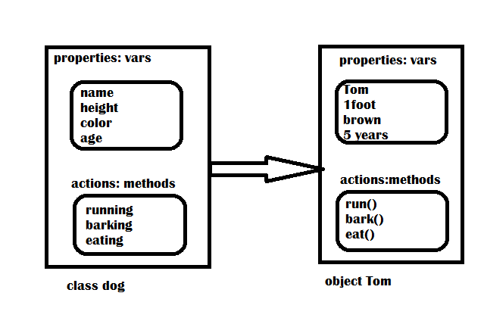
Class and Object

Slide 9
Class and object
Class is used as a model for creating objects.
A class and its objects are same with the difference that a class doesn’t exist physically, while an object does.

Slide 10
Features of Java
Distributed: Information is distributed on various computers on network. Using java, we can write programs, which can capture information and distribute it to clients.
Robust: means strong. Java programs are strong and they don’t crash easily like c and C++.
There are two reasons.
1) Java has got excellent inbuilt exception handling features.

Slide 11
An exception is an error that occurs at runtime. If exception occurs program terminates abruptly and giving rise to problem lose of data. To over come the problem we are having exception handling.
→ Another reason is Memory Management.
In c and C++ if no sufficient memory or memory is not freed in a program then program crashes in the middle. But in Java allocation and DE allocate automatically.
JVM is also capable of deallocating the memory when it is not used.
Garbage collector is a form of memory management that checks the memory from time to time and frees the memory which are not in used.

Slide 12
Secure: security problems like eavesdropping ,tampering ,impersonation and virus threats can be eliminated or minimized.
System Independence: It can be run on any machine.
Portability : if program yields same results on every machine, then that program is called portable.
Interpreted : Java programs are compiled to generate the byte code. This byte code can be downloaded and interpreted by the interpreter in JVM.
Both Compiler and Interpreter will be used in JVM.
High Performance: problem with interpreter inside the JVM is that is slow. To over come this problem javasoft people have introduced JIT(Just in Time) Compiler to increase the speed if execution.

Slide 13
MultiThreaded: A thread represents an individual process to execute a group of statements. JVM uses several thread to execute different blocks of code.
Creating multiple thread are called Multithreading.
Scalability : Java can be implemented on a wide range of computers.
Dynamic : Before the development of java, only static text used to displayed in browser. But in java applets are used for dynamically interacting program.

Slide 14
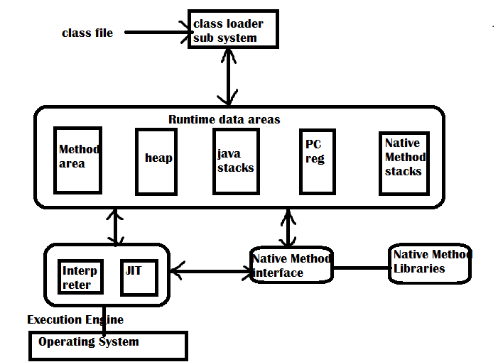
Java Virtual Machine(JVM)
Components in JVM Architecture.

Slide 15
How JVM works
JVM(Java Virtual Machine) acts as a run-time engine to run Java applications. JVM is the one that actually calls the main method present in a java code. JVM is a part of JRE(Java Runtime Environment).
Java applications are called WORA (Write Once Run Anywhere)
Class Loader Subsystem It is mainly responsible for three activities.
Loading
Linking
Initialization

Slide 16
JVM
Loading---The Class loader reads the .class file, generate the corresponding byte code and save it in method area
Linking : Performs verification, preparation, and (optionally) resolution.
Verification : It ensures the correctness of .class file i.e. it check whether this file is properly formatted and generated by valid compiler or not. If verification fails, we get run-time exception java.lang.VerifyError.
Preparation : JVM allocates memory for class variables and initializing the memory to default values.
Resolution : It is the process of replacing symbolic references from the type with direct references. It is done by searching into method area to locate the referenced entity.
Initialization : In this phase, all static variables are assigned with their values defined in the code and static block(if any).

Slide 17
JVM is the heart of entire java program execution process.
JVM takes .class file and converts in each byte code instruction into machine language.
In JVM , there is a module(or program) called class loader sub system, which performs the following functions:
-→ First of all, it loads the .class file into memory
→it verifies whether all the byte code instructions are proper or not. If it finds any instruction suspicious, then execution is rejected immediately.

Slide 18
The memory is divided into 5 parts, which contains data and results while running the program.
1)Method area : Method area is memory block, which stores the class code, code of the variables, methods of java program.
2)Heap : This is the area where objects are created. When ever JVM loads a class, a method area and heap will be created immediately.
3)Java Stacks: Method are is stored on method area. But while running a method, it need some more memory to store the data and results.
While executing a method, a separate frame will be created in java stack, where the method is executed. JVM uses a separate thread to execute each method.
4)PC(Program Counter) registers: These are the registers(memory areas), which contains memory address of the instructions of the methods. If 3 methods are there then, 3 PC registers will be used to track the instruction of methods
5)Native Methods Stacks: Java methods are executed on Java stacks. Similarly native methods(C,C++) execute on here.

Slide 19
Execution Engine
Execution engine contains interpreter and JIT(Just In Time) compiler which are responsible to convert the byte code into machine code.
So processor executes the machine code.
JVM uses interpreter and JIT compiler simultaneously known as Adaptive optimizer.
Why we need both interpreter and JIT compiler to work simultaneously?
After loading the .class code into memory. JVM first identifies which code is to be left to interpreter and which one to JIT. So it improves the performance.

Slide 20
Parts of Java
Oracle (Sun microsystems Inc ) has divided Java into 3 parts
Java SE(Java SE 14.0.1)- Java Standard Edition contains basic core java classes. This edition is used to develop standard applets and applications
Java EE: Java Enterprise Edition and it contains class that are beyond java SE and concentrates on providing business solution on network.
Java ME: Java Micro Edition and for develop code for Portable device,2 Tabs, mobile phones etc. Code on these device need to be small in size and should take less memory.
Reference:
https://www.oracle.com/java/technologies/javase-downloads.html
Or
https://www.java.com/en/download/

Slide 21
Interview questions
Why pointers are eliminated from Java?
Pointers leads to confusion of programmer.
Pointers may crash a program easily. When you add two pointers the program crashes immediately.
Pointers break security and harmful program like virus and other hacking programs can be developed
Because of above reasons pointer have been eliminated from java.

Slide 22
Interview questions
What is the difference between a function and a method?
A method is a function that is written in a class. We don’t have functions in java. Method should be written inside the class only.
In C++ we can write method inside or outside the class.
What is JIT compiler?
JIT compiler is the part of JVM which increases the speed of execution of a java program.

Slide 23
→Which part of JVM will allocate the memory of java program?
A)Class loader subsystem of JVM will allocates the necessary memory needed by the java program.
→Which algorithm is used by garbage collector to remove the unused variables or objects from memory.
A)Garbage collector uses many algorithms but most commonly used algorithm is Mark and sweep.
→How can you call the garbage collector?
A)Garbage collector is automatically invoked when the program is being run. It can also called by calling gc() method of Runtime class or System class in Java.

Slide 24
Differences between C++ and JAVA
C++ | JAVA
C++ is not a purely Object-oriented programming language, since it is possible to write c++ programs with out using the class or an object | Java is purely Object-oriented programming language, since it is not possible to java programs with out using the class or an object
Pointers are available in C++ | We cannot create and use of pointers.
Allocating and deallocating memory is the responsibility of the programmer. | Allocating and deallocating memory is the responsibility taken by JVM
C++ has goto statements | Java does not have goto statement
Automatic casting is available in C++ | In some cases, implicit casting available. But it is advisable that the programmer should use casting whenever required.
Multiple Inheritance feature is available | No Multiple inheritance in java but there are means to achieve it.
Operator overloading is available | It is not available
There are 3 access specifiers, private, public and protected | 4 access specifiers private, public, protected and default.
There are constructors and destructors | Only constructors and no destructors availiable in java.

Slide 25
Thank you

